Slide 2
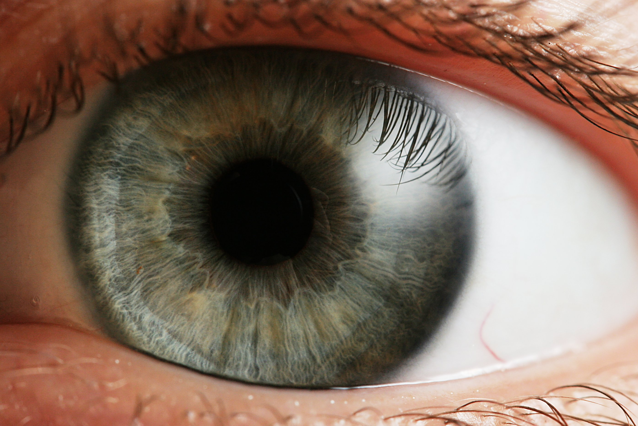
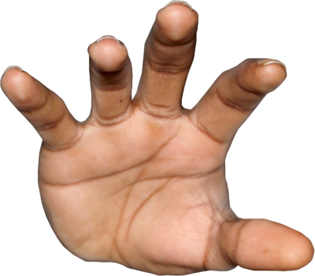

6cm ± 2cm
size?
4cm ± 1cm
Notes:
what’s the best guess? Is it closer to 4 or 6? Do you think there’s MORE uncertainty, or LESS?

Slide 3

6cm ± 0.5cm
size?
4cm ± 1cm
Notes:
what about after I remember to put in my monocle, and my margin of error on my visual estimate goes down to a half a centimeter?

Slide 4
probability
size (cm)

Slide 5
probability
size (cm)

Slide 6
Does the brain really do this?
Important to make predictions about behavior based on model.
Qualitative predictions: “when I increase x, y should also increase”
Quantitative predictions: “if I measure this thing, it will have value x”

Slide 7
An experiment!

Slide 8
Decide which of two objects are bigger.
One object has a cue conflict: felt and seen size are mismatched.
Cue combination predicts:
More reliable cue is weighted more
Weights are directly proportional to reliability
Reliability of two cues sums.

Slide 9
Notes:
(walk through this slowwwwly)

Slide 10
Bayesian modeling
Represent uncertain information
Everything is a probability distribution
Usually describe optimal performance for a task, given certain information and assumptions about task structure.
Not always directly related to actual cognitive processing or neural activity.

